Slide 1
ADVANCED REACT
Hooks Deep Dive

Slide 2
Objectives
In this module, you will
Be introduced to the concepts and motivations behind using Hooks
Understand and use the most common hooks in React
useState, useEffect, useRef, useCallback, useReducer, useMemo, useContext
Build your own custom hooks with your own functionality

Slide 3
What are they?
Hooks are nothing more than named blocks of functionality, designed to make it easier to create efficiently coded web pages.
The built-in hooks can be generally split into categories
State Hooks useState and useReducer
Performance Hooks useMemo and useCallback
Reference Hooks useRef and useImperativeHandle

Slide 4
How do we use them?
Hooks have to be imported into any component that needs to use them.
As the hooks are not the default import, we need to import them as objects, hence the curly braces
We can separate multiple hook imports with a comma.

Slide 5
General Rules
3 general rules of use:
Only call Hooks at the top level. Don’t call Hooks inside loops, conditions, or nested functions
Only call Hooks from React function components
Don’t call Hooks from regular JavaScript functions

Slide 6
useState()

Slide 7
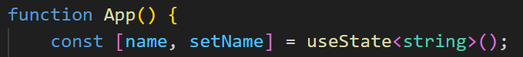
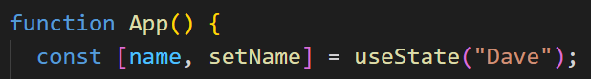
useState()
When you create a ‘variable’ with use state, you need to create a const, then within an array, specify the name of the const followed by the setterName.
This second element allows you to update the state value
state name setter function name
Inside the parenthesis, you need to specify the initial value of this state

Slide 8
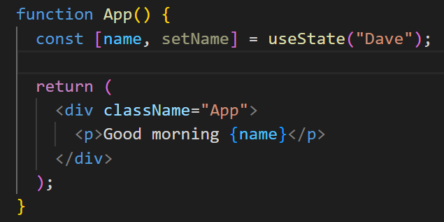
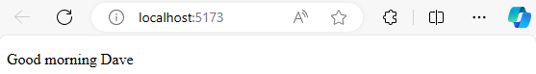
useState()
In the JSX return, we can now dynamically output the state value

Slide 9
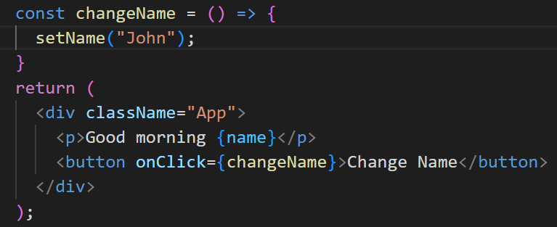
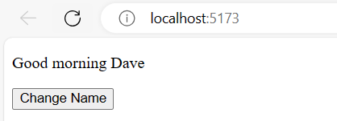
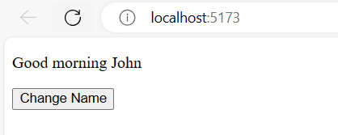
useState()
To update the value, we need to create a function.
The most common way is to create a button which calls the setter function

Slide 10
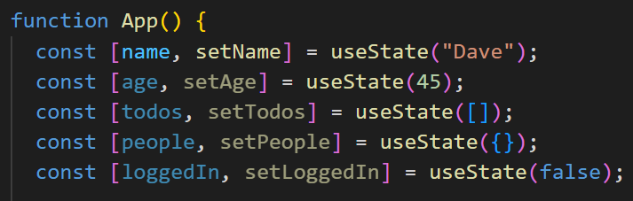
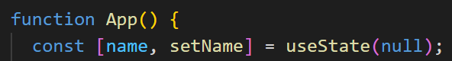
useState()
State can be set as string, numbers, arrays, objects and Boolean values
They can also be set to null, where they are instantiated but not assigned

Slide 11
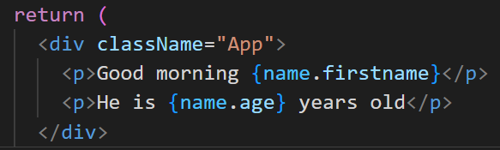
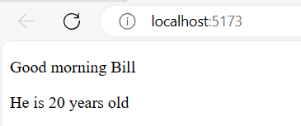
useState()
Objects held within state can be accessed like props, with dot notation

Slide 12
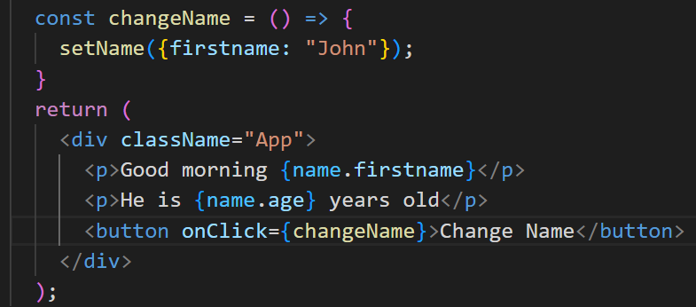
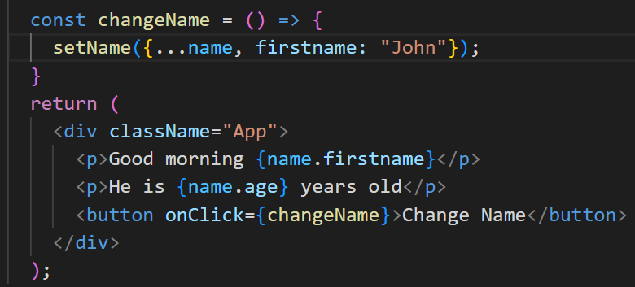
useState()
You can still change the object with functions, you just need to identify which key to change when the function is called
This is bad practice as it would have removed the second property from the state. We get round this by using the spread operator (…)

Slide 13
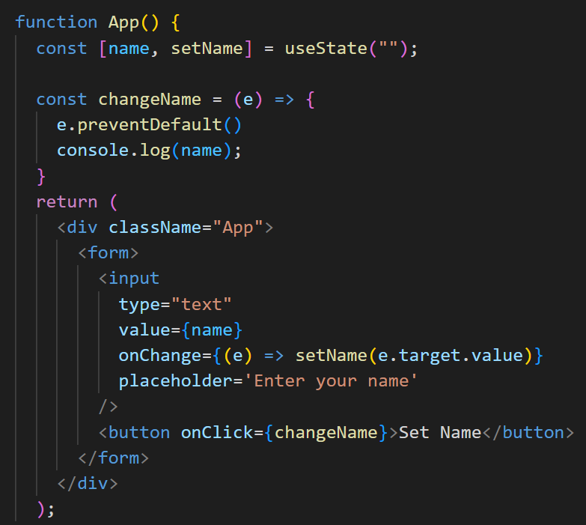
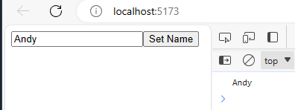
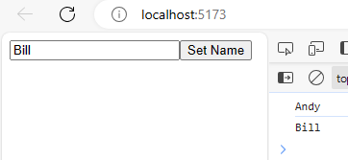
useState()
The user can set the value by using a form input and updating the state whenever the user changes the data

Slide 14
useEffect()

Slide 15
useEffect()
Replaced the 3 different lifecycles
componentDidMount
componentDidUpdate
componentWillUnmount

Slide 16
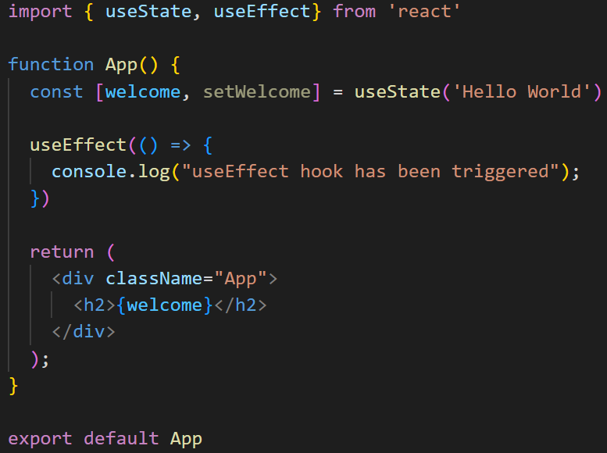
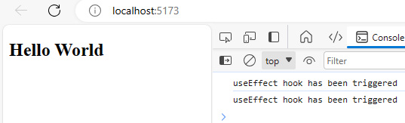
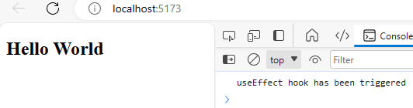
useEffect()
When you build a useEffect hook, the first argument is the handler function.
This takes care of any side effect
It renders twice because the strictMode is wrapping the App in main.jsx. (we will take this off for this example)
Notes:
It renders twice because the strictMode is wrapping the App in main.jsx.

Slide 17
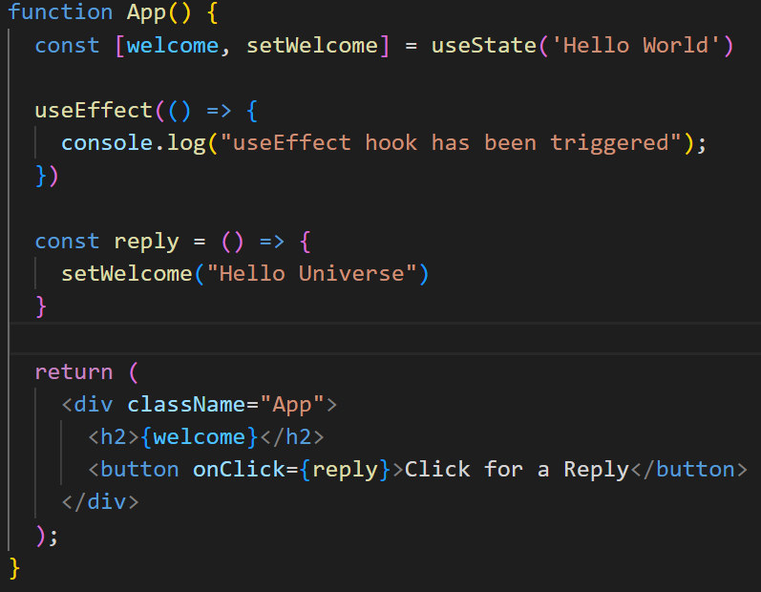
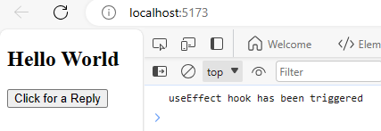
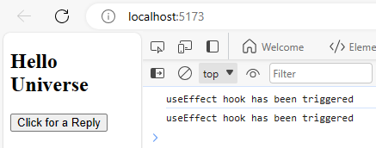
useEffect()
We can also demonstrate the componentDidUpdate by changing the state within the component

Slide 18
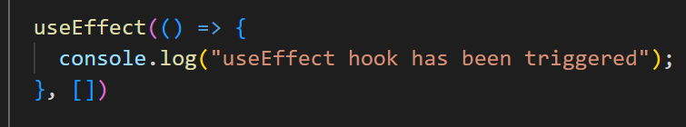
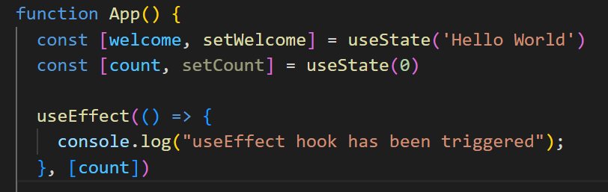
useEffect()
This behaviour can be prevented by adding a second argument to the useEffect hook.
Adding an empty array will tell the hook to only triggered on mounting
This is a dependency and it tells the hook which state changes should trigger a rerender
This would now only trigger when the count state was updated

Slide 19
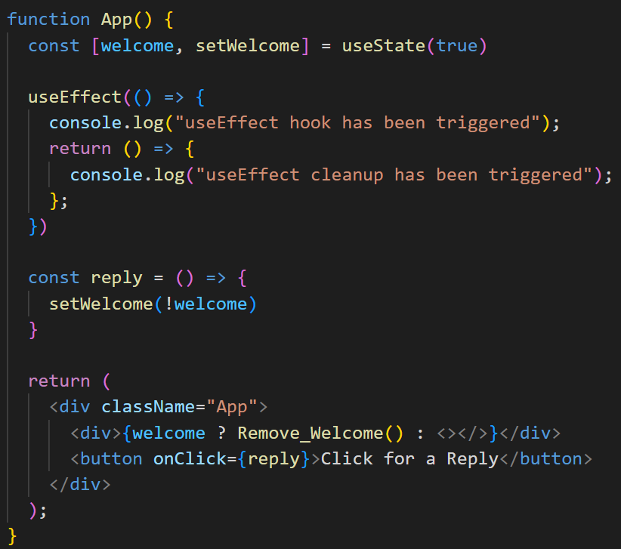
useEffect()
The last of the component lifecycle stages can be demonstrated within useEffect also
Welcome state has been set to true
Reply sets the state to false
Ternary operator to check if welcome is true

Slide 20
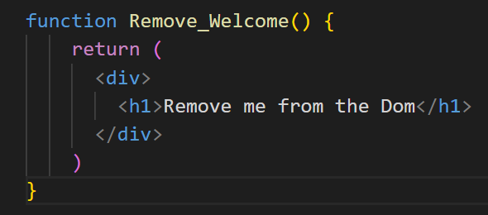
useEffect()
The last of the component lifecycle stages can be demonstrated within useEffect also
When the element is removed from the DOM, the return is triggered

Slide 21
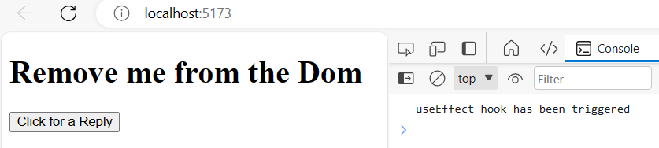
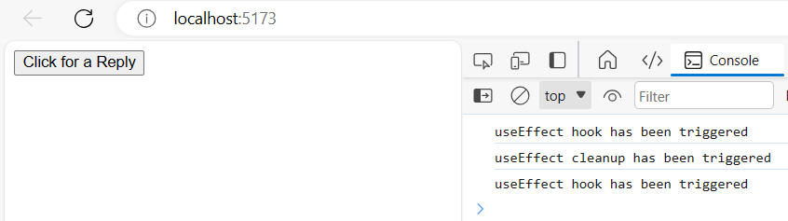
useEffect()
Element is loaded to the DOM and the useEffect is triggered
When the button is clicked, the element is removed from the DOM and the return is triggered
As the state was changed, the useEffect was then triggered again

Slide 22
useContext()

Slide 23
useContext()
This hook makes it easier to pass data throughout the whole of your component tree, without the need to pass props from parent to child.
We will investigate this in more detail when we look at state management later in the week
We have useContext to avoid the issue of propDrilling between multiple levels of parent and child components

Slide 24
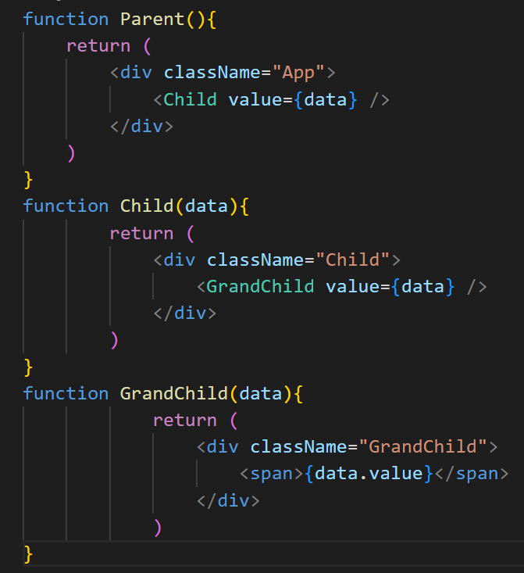
useContext()
It might look like this with multiple levels, and much worse. We want to be able to pass data by traversing components

Slide 25
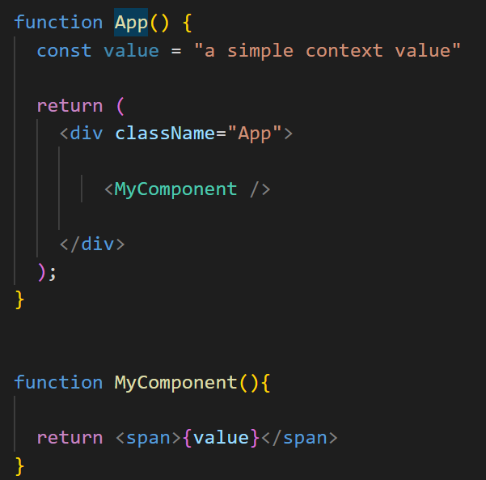
useContext()
Imported from react like all other hooks
CreateContext and useContext are both needed because we need to provide and use the context to send and receive data

Slide 26
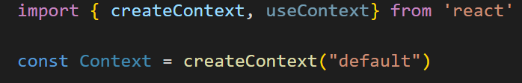
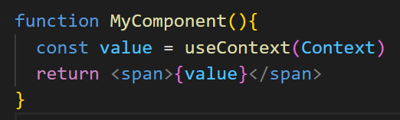
useContext()
First, we create the context
This names the context of the data to be passed through the component tree
We need to utilise the useContext hook in any component we want to pass the data into

Slide 27
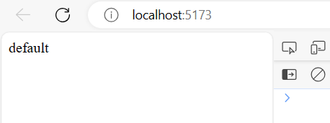
useContext()
This will display in the child component despite not being mentioned in the parent component

Slide 28
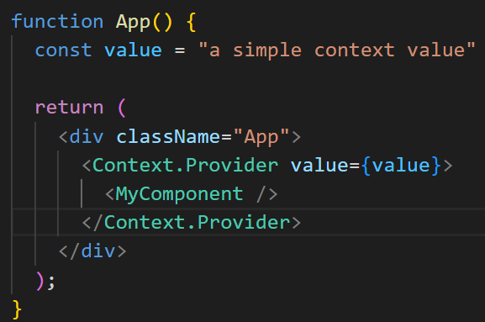
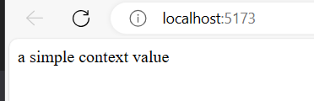
useContext()
We can use Context.Provider inside the parent app to change the value of the context before it is passed to the child.
This allows us to send different context to different children anywhere in the tree, based on state requirements

Slide 29
useReducer()

Slide 30
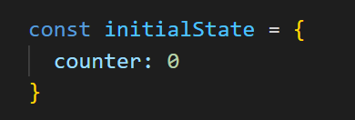
useReducer()
This shipped with react v16 and is an alternative to useState(). It is used to store and update states
Like useEffect, it takes in 2 arguments, but looks like useState when it is written
Initial state is a simple value that the state is assigned with. This can be created separately, or dropped into the creation

Slide 31
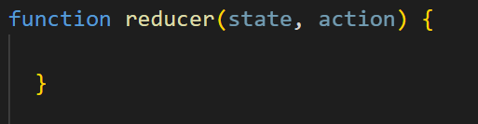
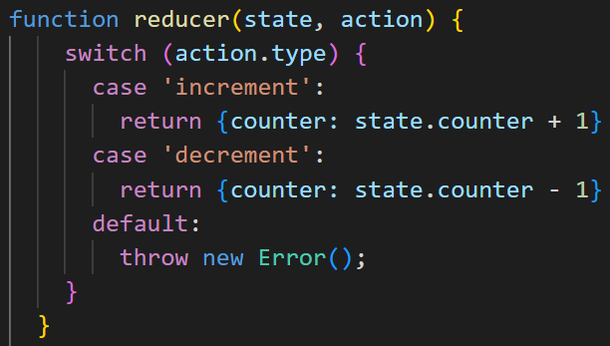
useReducer()
You need to create the reducer function too.
Based on the action, the function returns updated state based on which action we pass into the reducer call, we move through a switch statement to see how to change the state

Slide 32
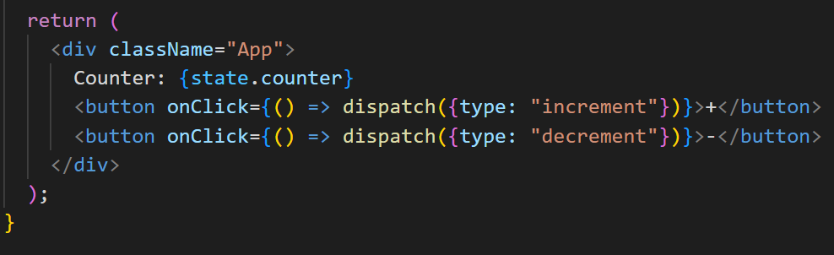
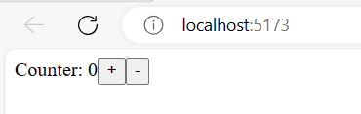
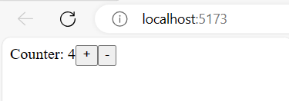
useReducer()
Inside the return, you need to identify the state and create some functions which call the reducer, but identify the type of action

Slide 33
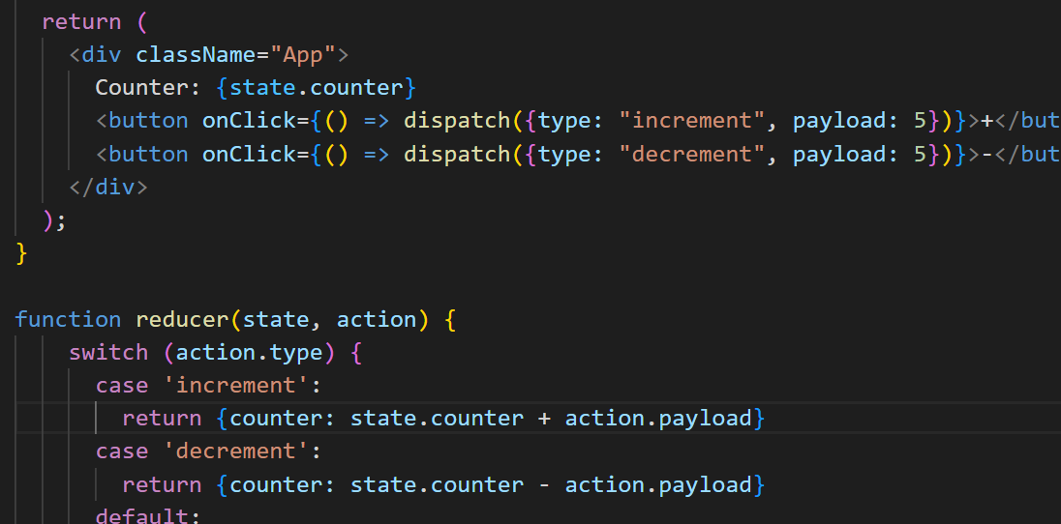
useReducer()
You can also use a ‘payload’ property to change how many the counter should increment and decrement by

Slide 34
useRef()

Slide 35
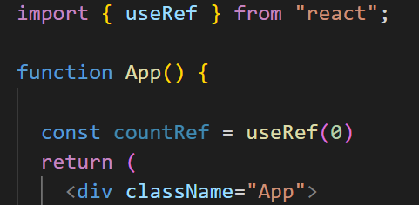
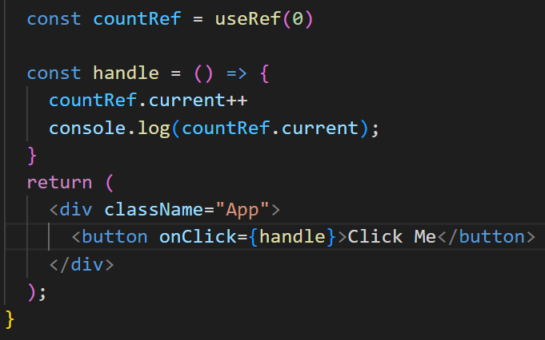
useRef()
This built in hook accepts one argument as an initial value and returns the reference.
Syntax is simple (useRef is mutable)
You can update the value with a function

Slide 36
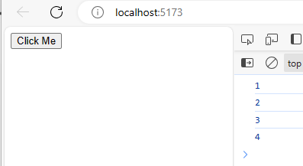
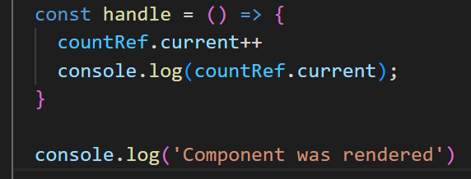
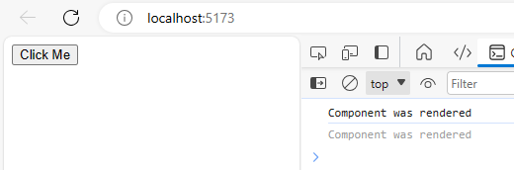
useRef()
Each time the button is clicked, it updates the ref and passes it to the console
The component was rendered initially but…..

Slide 37
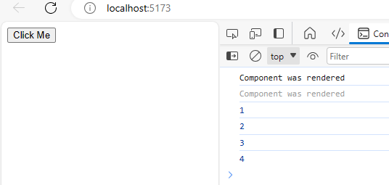
useRef()
As the useRef is not a state change, it doesn’t trigger a re-rendering of the component

Slide 38
useCallback()

Slide 39
useCallback()
useCallback will return the memorised version of a function that only changes when one of the dependencies has changed.
Memorisation is a way to cache results so they don’t have to be calculated again.
useMemo is similar, but useCallback is for functions, not values

Slide 40
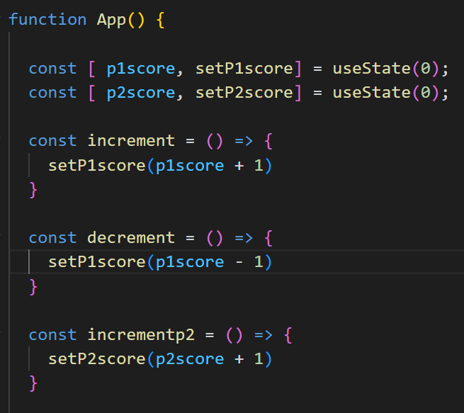
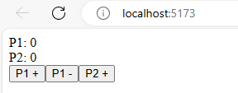

useCallback()
It is easier to understand when to use this hook when you see how not using it causes a problem
Every time this component re-renders, every function inside this component is recreated. Hence the function references change between renders

Slide 41



useCallback()
If we create a set(), we can see this in real time
The initial render of this component shows that 3 functions have been created.

Slide 42

useCallback()
If I click a button, the subsequent state change and re render creates the 3 functions again, but with different references
This could add a huge performance issue. This is where useCallback will come in handy.
Similarly to other hooks, it takes 2 arguments. The function and the dependencies

Slide 43

useCallback()
By adding useCallback, we can determine which functions are recreated on re-render
Increment is only recreated when p1score is updated
Incrementp2 is only recreated when p2score is updated

Slide 44



useCallback()
This time, we still get 3 function references in the initial render
If I press P1+, it increments to 5, not 6
If I press P2+, it increments only one more reference as only one function needs to be recreated

Slide 45

useCallback()

Slide 46


useCallback()
Best practice is to try and remove the dependencies. This will ensure that the only rendering of these functions is at the initial render

Slide 47
useMemo()

Slide 48
useMemo()
Essential for improving performance and speed by caching output in memory, then returning that value when the same input is given
useMemo is called and accepts 2 arguments.
The first is the function (compute), the second is the dependencies
Similar to useCallback, but used for values rather than functions

Slide 49




useMemo()
Another problem that needs a solution
Every time the button is clicked, it re-renders both
parent and child components

Slide 50


useMemo()
With useMemo we can store the value of the function and as long as it doesn’t change, the child will never be re-rendered

Slide 51



useMemo()
Lets add new state and include that as a dependency in the useMemo for the child component
The child component is only rerendered when newState is updated

Slide 52
Custom Hooks

Slide 53
Custom Hooks
Sometimes we write our own blocks of functionality that are useful to our codeblocks.
Regularly, these can be used over again with multiple components.
We may be tempted to save these as functions and then export them. However, React allows us to create our own hooks, this has a major benefit.
Once you create a hook which starts with the word ‘use’, it allows the linter to find bugs in the hook.

Slide 54
Custom Hooks
It is important to note that the general rules of react hooks also apply to custom hooks
Just in case…
Only call Hooks at the top level. Don’t call Hooks inside loops, conditions, or nested functions
Only call Hooks from React function components
Don’t call Hooks from regular JavaScript functions

Slide 55

Using local storage
When it comes to the storage of session keys and other snippets of information we might need to use.
Let’s build a custom hook that lets us use this persistent storage
When we type into the box and refresh, the data is lost.
We can easily change this to store the value locally, i.e inside the browser

Slide 56


Using local storage
Create a new component called useLocalStorage.jsx. We want this to work similarly to useState, in that it will return a value and a function that lets you set a value.
Inside our component, we now call this custom hook in, rather than useState

Slide 57


Using local storage
If we prime our hook to accept the initial value, it can then utilize useState within the hook and change the functionality
We can now create the logic for persisting local data. In our component, we need to pass the key into our hook. name is the key we will use

Slide 58

Using local storage
As local storage uses JSON, we need to create a function that allows our hook to check if a local value exists.
When the page is refreshed, it will run and the return the local value into the text box
As useState can accept a function, we need to check if a function has been passed in (in which case it returns whatever was passed to it)

Slide 59

Using local storage
Now, we need to call the getLocalVariable function based on what is passed on refresh.
The best way to update the local storage is to apply useEffect as this will re-run automatically on re-render.
Returning the value will populate the textbox with anything that already exists in localStorage

Slide 60


Using local storage
The result is a key of name being put into Local storage when the page is rendered
This is then updated when a name is entered into the text input

Slide 61
Using local storage
Upon page refresh and subsequent re-render, this is stored and put into the text input automatically

Slide 62


Another example
Logging is something that is regularly used across many components.
We can create a new useLog hook which records changes to the console

Slide 63

Another example
Now we have 2 blocks of functionality outside the main App.jsx.
Not only is the complexity removed from the component, it is completely reusable for all other components too

Slide 64
Labs and Activities

Slide 65
Challenges
Create a custom hook called useFetch which accepts a URL as a parameter to instantiate an API call and return the data
Create a custom hook called useEventListener to an element of a webpage

